Slide 1
CUSTOMER RETENTION
PROBLEM STATEMENT AND UNDERSTANDING

Slide 2
PROBLEM STATEMENT
Trust of customers towards online store is major factor for attracting customer . Data of customers should be safe with online store. Information among a particular product should be provided briefly and understandable to customers. As we know, e-commerce is a competitive field, to attract customers company want to provide offers , benefits , returns and replacement and always response for customers query. These factors for success of the online store. There are some step to for customer retention , it means attracting existing customer and repurchasing from website.

Slide 3
Utilitarian and hedonic values
One of the major factor of customer retention is combination of utilitarian value and hedonic value . Utilitarian values means value that a customer receives based on a task-related and rational consumption behaviour. It means customer buy a product among information about the product . For example, Buying a phone. Smart phones provide basic features and advanced features. Buying an I phone and any other phones. I phone is expensive, an ordinary people buy other smartphones under 20000 instead of buying I phones . This type of customer believe that the phones under 20000 provide their basic needs.

Slide 4
While hedonic values are the opposition of utilitarian values. It defines the value received from the multisensory, fantasy and emotive aspects of the shopping experience . For example buying an I phone will make socially valuable and it is luxurious.
There are some factors affecting for this utilitarian and hedonic values. Factors should be done to the customers. Then only our problem should be cleared.

Slide 5
EDA
STEPS AND VISUALIZATIONS

Slide 6
STEPS
Check the data types of columns. Each columns are of integer data types.
Number of rows and columns are 269 rows and 21 columns respectively.
No missing values were present in the file.
Visualized each column using count plot.
Compare each column using boxplot.
Pair plot plot is used for analysis of multiple variable.

Slide 7
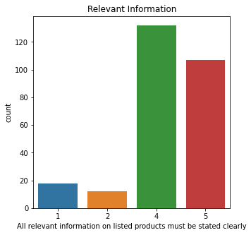
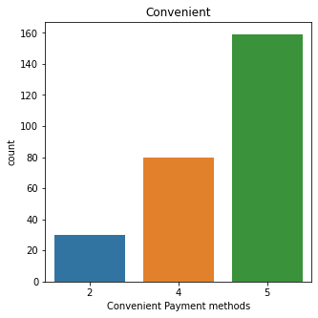
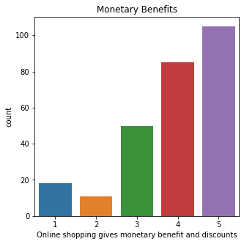
VISUALIZATIONS

Slide 8
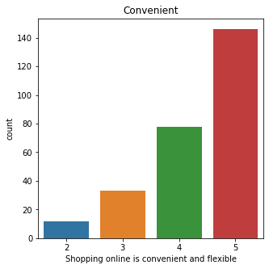
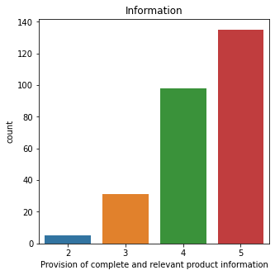
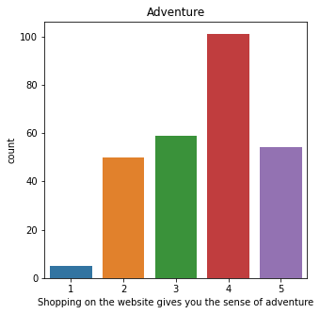

Slide 9
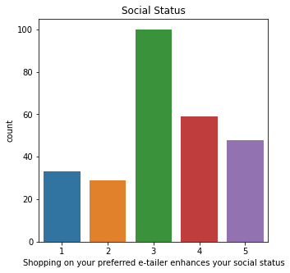
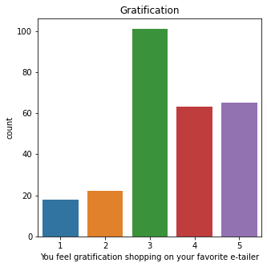
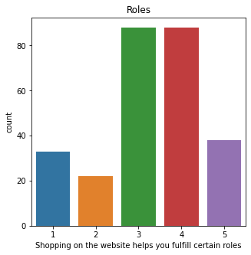

Slide 10
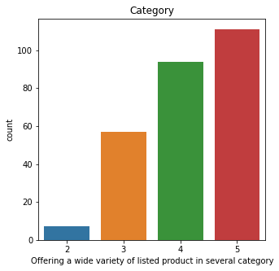
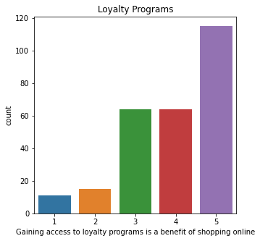
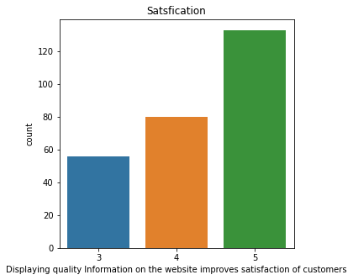

Slide 11
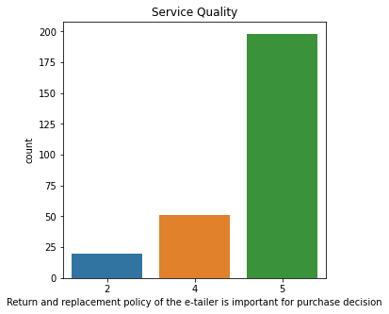
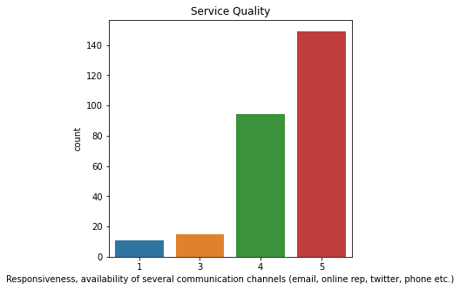
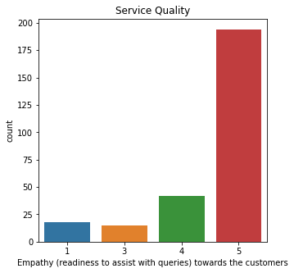

Slide 12
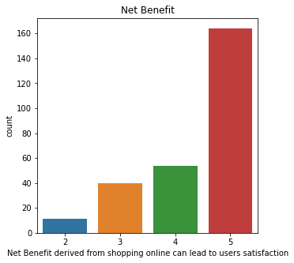
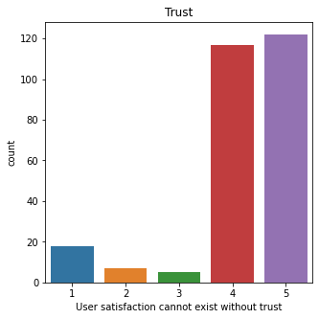

Slide 13
